Slide 1
CS 513-B
Knowledge Discovery and Data Mining

Slide 2
SKYSCORE
Machine Learning for Passenger Satisfaction Insights

Slide 3


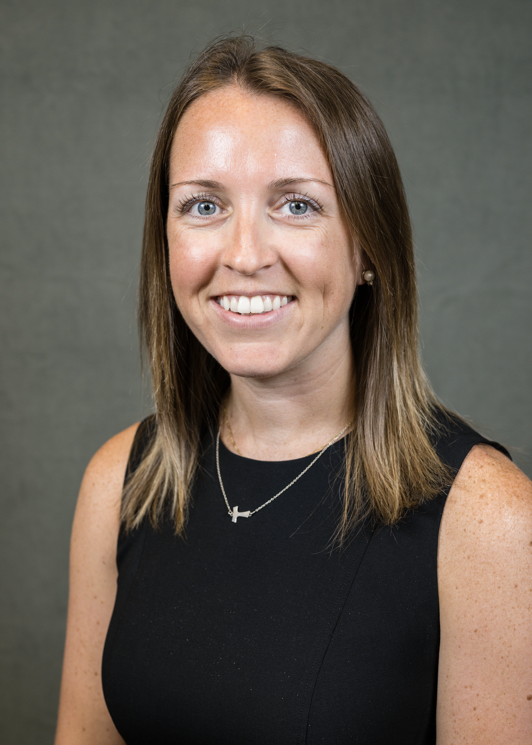

The Team
Pradhyumna Nagaraja Holla 20032105
Rohi Dinesh Bindal 20031243
Sarah Murphy 20026527
Aditya Dineshkumar Champaneri 20029562

Slide 4
What drives passenger satisfaction in modern air travel?

Slide 5
The Problem

Slide 6
Airlines struggle to maintain consistent service quality across their extensive flight networks, leading to varying passenger experiences
Travelers demand personalized experiences and superior service across multiple sectors, from booking to baggage claim, making satisfaction management complex
Airlines face significant challenges in real-time monitoring of passenger satisfaction, often discovering issues only after receiving negative feedback
The industry lacks effective tools to predict and prevent customer dissatisfaction, resulting in reactive rather than proactive service improvements
Our objective is to develop a machine learning classifier that accurately predicts passenger satisfaction by analyzing key indicators, enabling proactive service enhancements and improved resource allocation

Slide 7
The Dataset
https://www.kaggle.com/datasets/johndddddd/customer-satisfaction/data

Slide 8
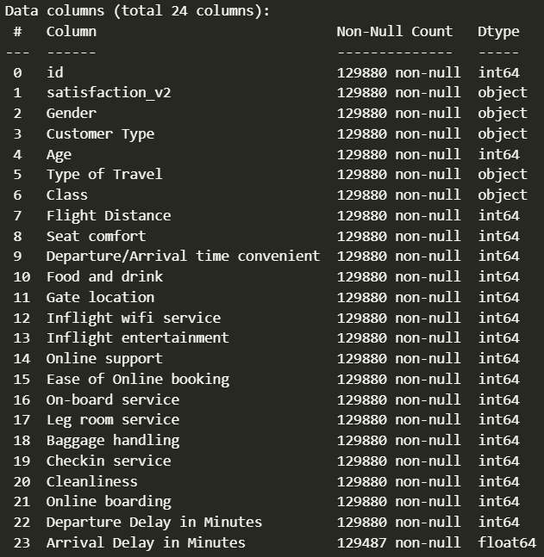
129880 rows, 24 columns, including the target
5 Categorical Columns, 19 Numerical Columns
Binary Target Variable: satisfaction - Satisfied/Neutral or Dissatisfied
Minimal missing values, hence they are removed
Most of the numerical values are ratings which span from 0 to 5

Slide 9
The target variable 'satisfaction' shows a balanced distribution with 55% satisfied and 45% dissatisfied passengers, enabling unbiased model training.
Customer loyalty data reveals a mix of 82% regular passengers and 18% non-regular travelers, providing insights into both experienced and new customer perspectives.
The dataset includes important pre-flight and post-flight metrics like ease of online ticket booking, departure/arrival delays etc., capturing the complete journey experience.
Service ratings follow a consistent 0-5 scale across 14 different aspects including seat comfort, cabin staff, and online booking, allowing standardized comparison.
Travel class distribution shows 48% Business class, 45% Economy class, and 7% Economy Plus passengers, representing diverse service level experiences.

Slide 10
Exploratory Data Analysis

Slide 11
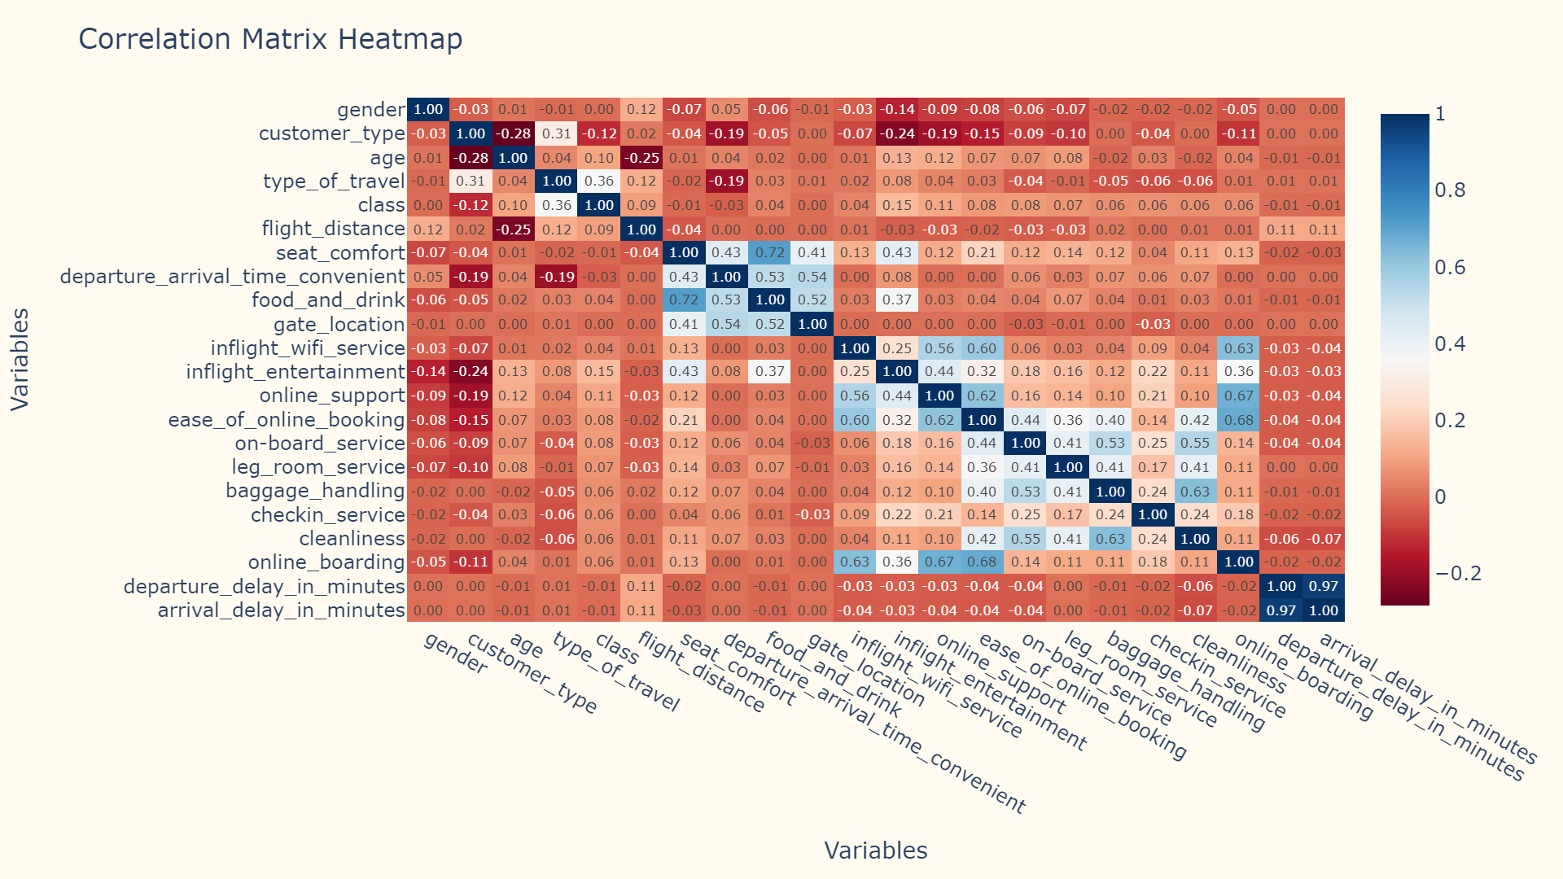

Slide 12
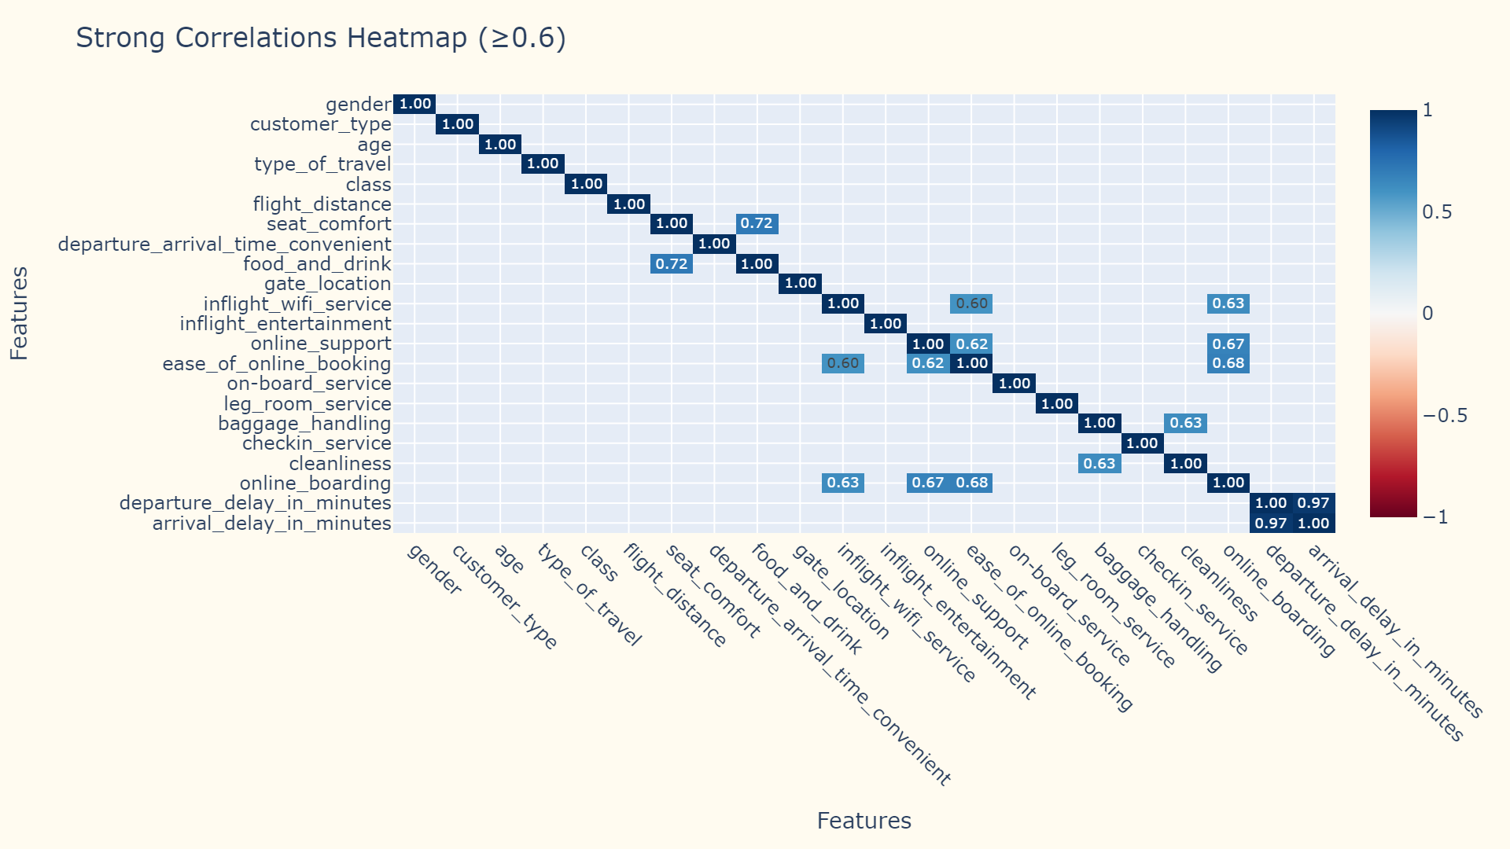

Slide 13
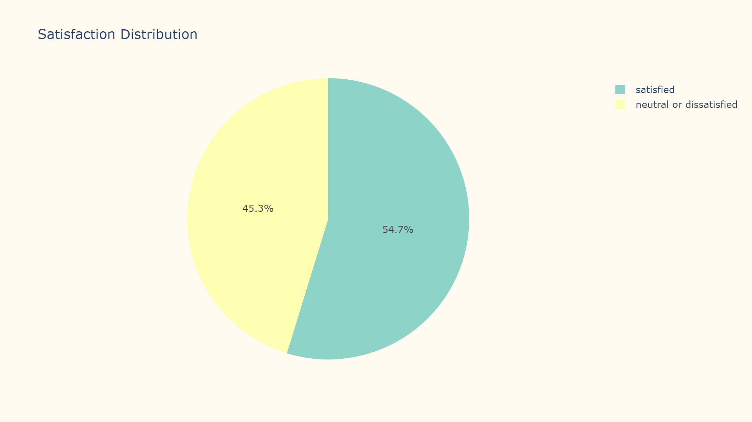

Slide 14
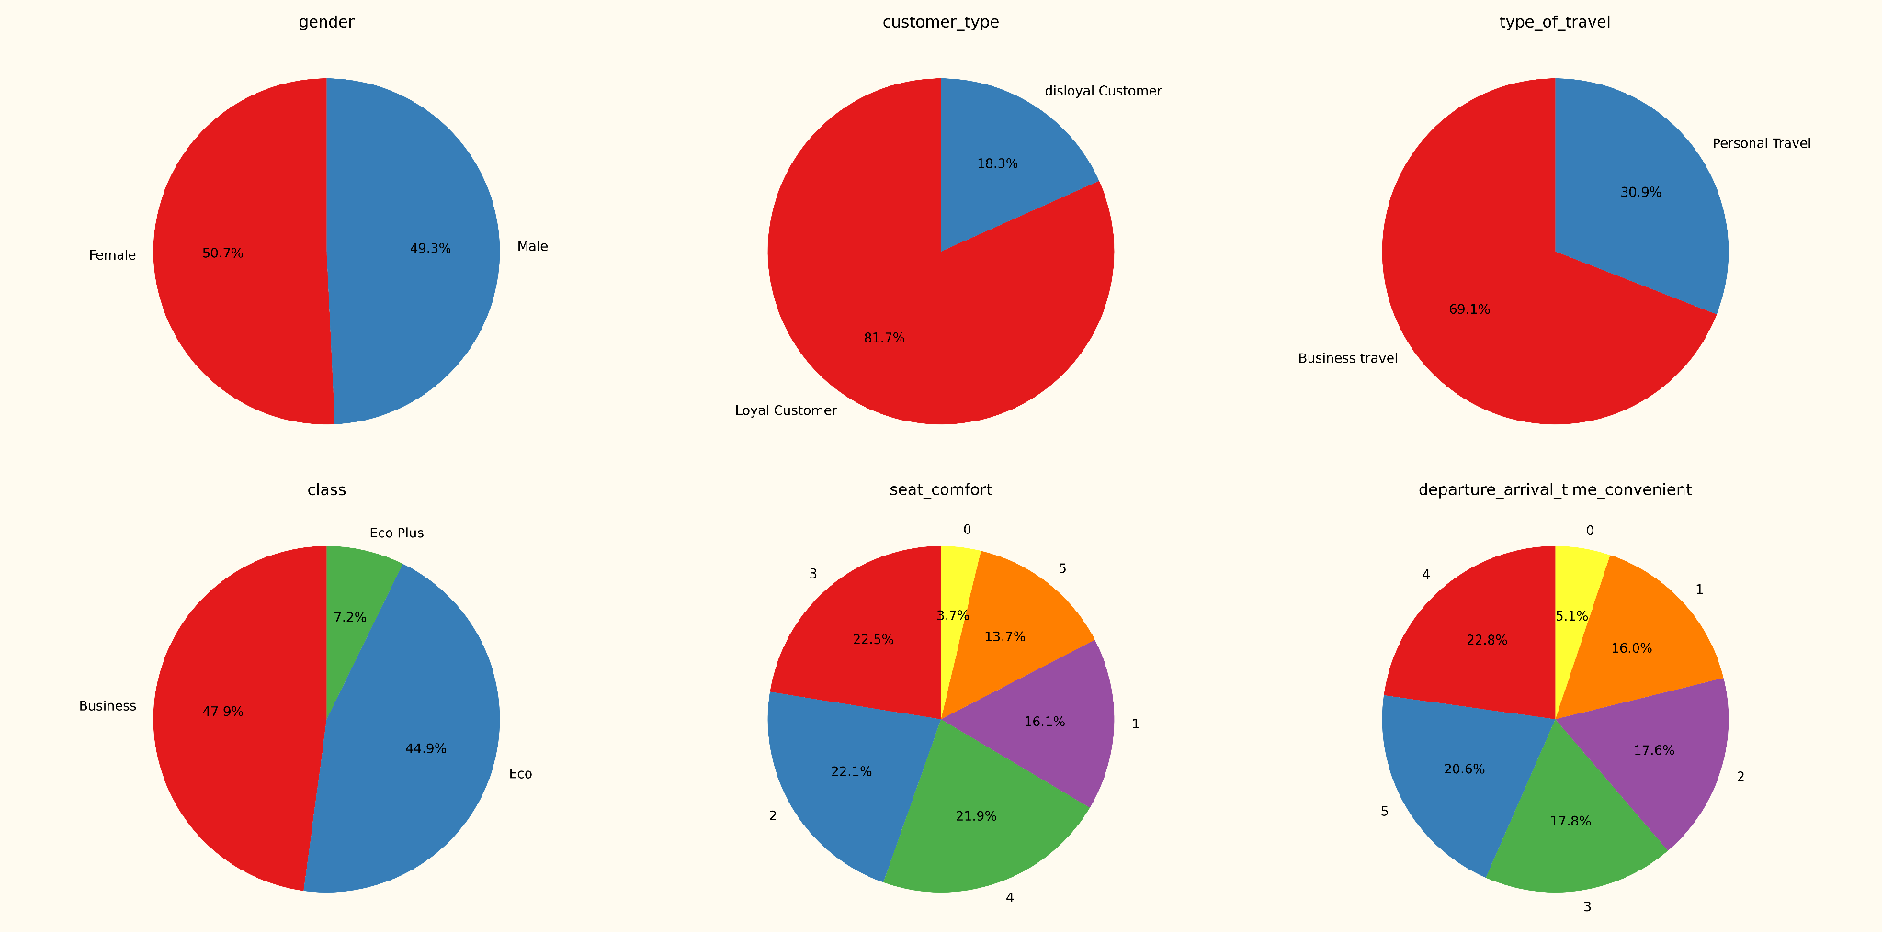

Slide 15
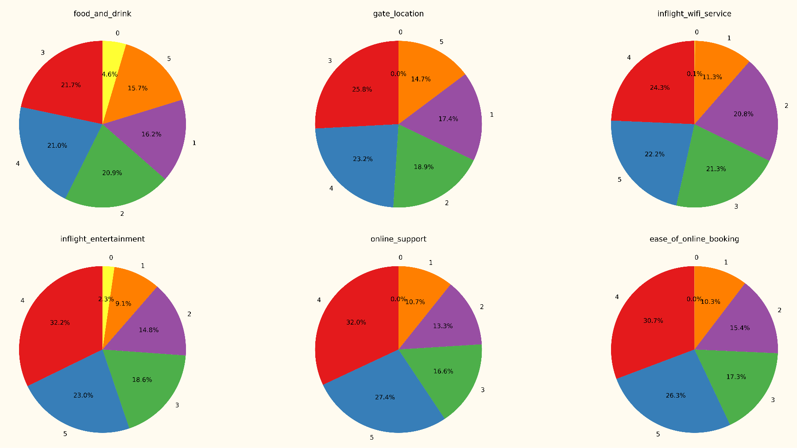

Slide 16
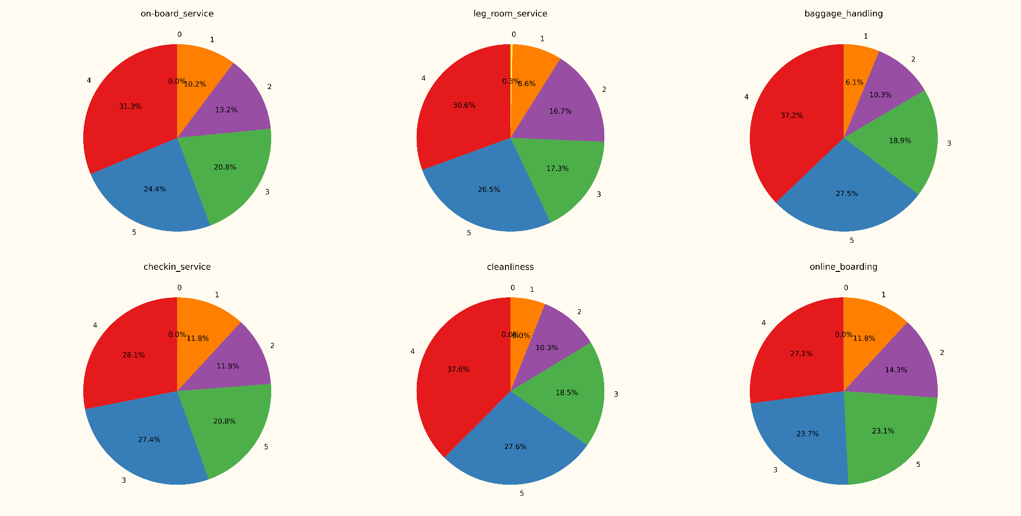

Slide 17
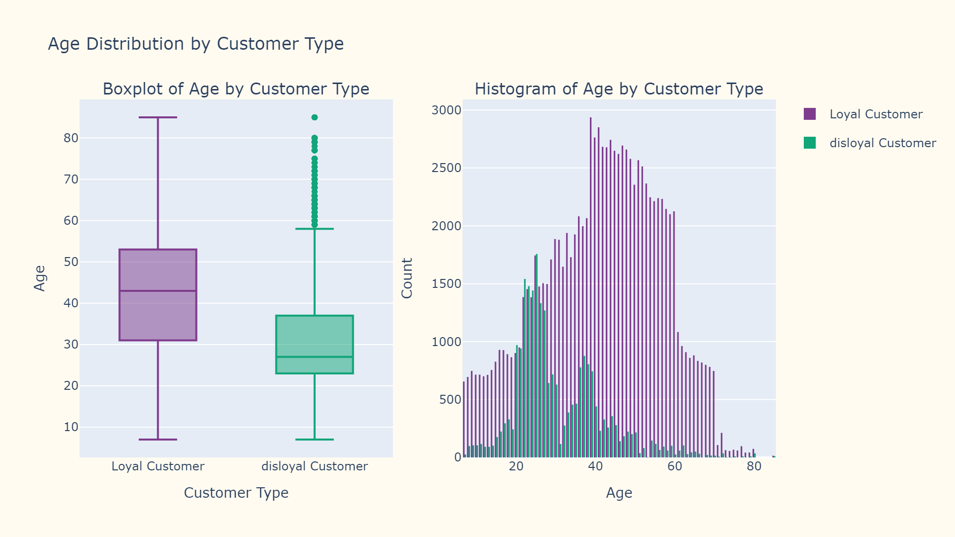

Slide 18
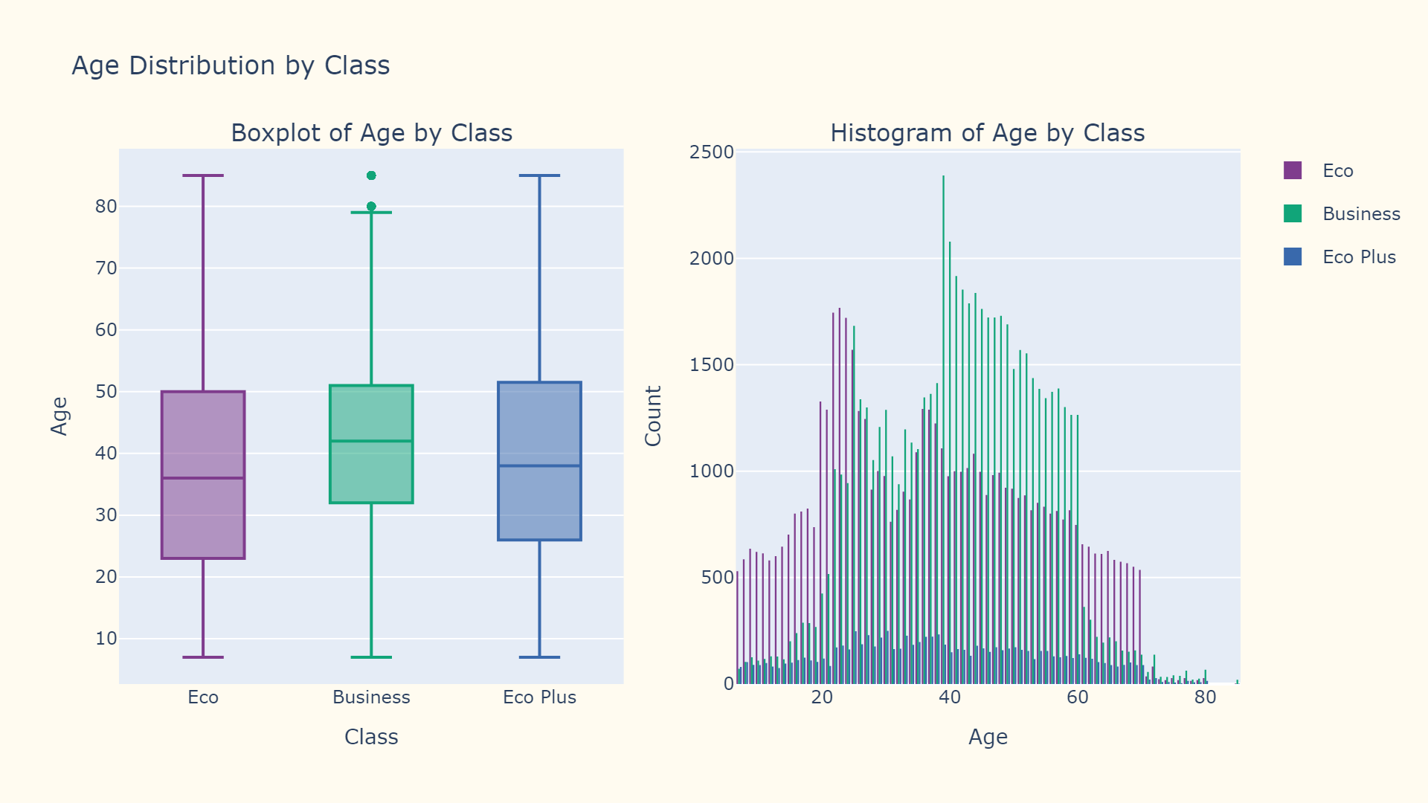

Slide 19
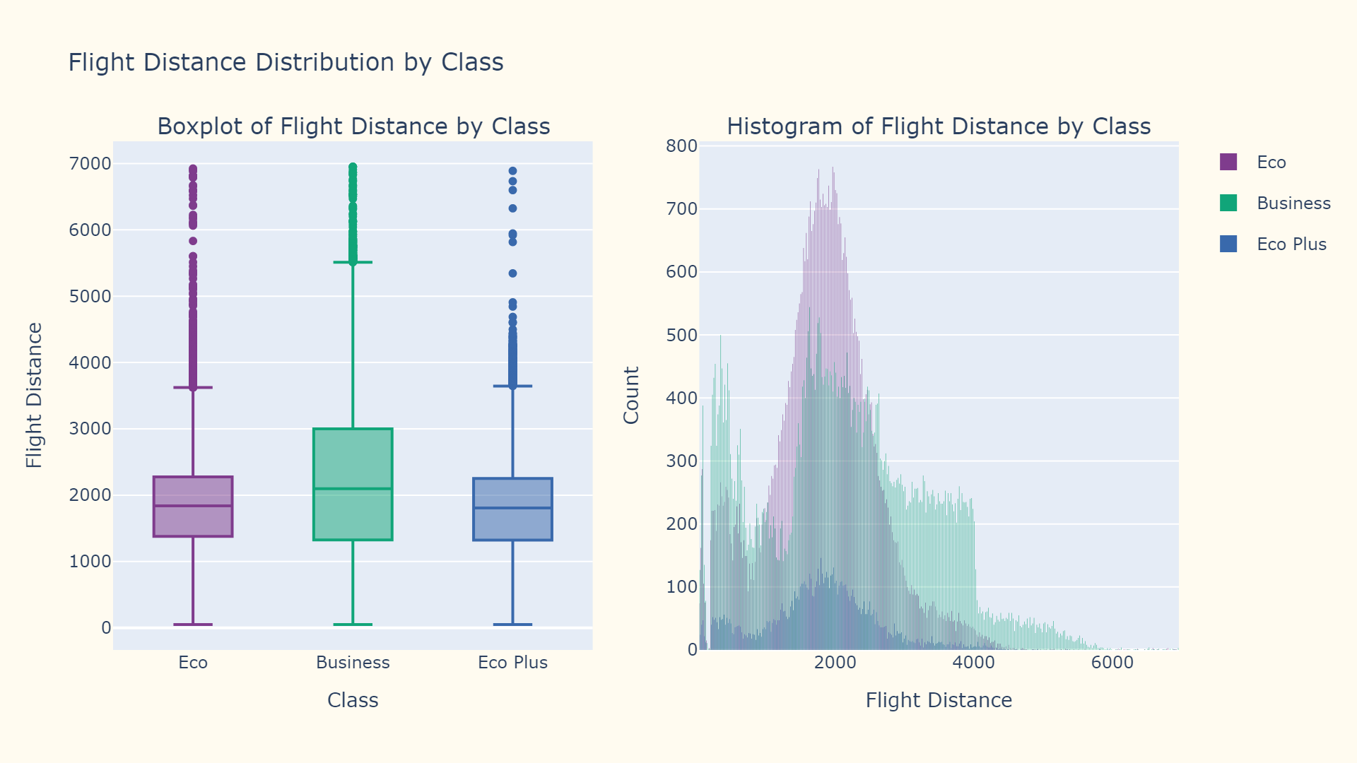

Slide 20
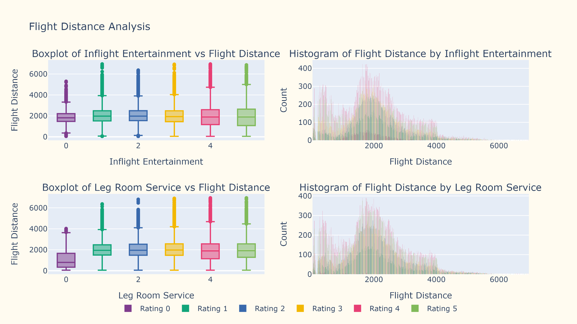

Slide 21
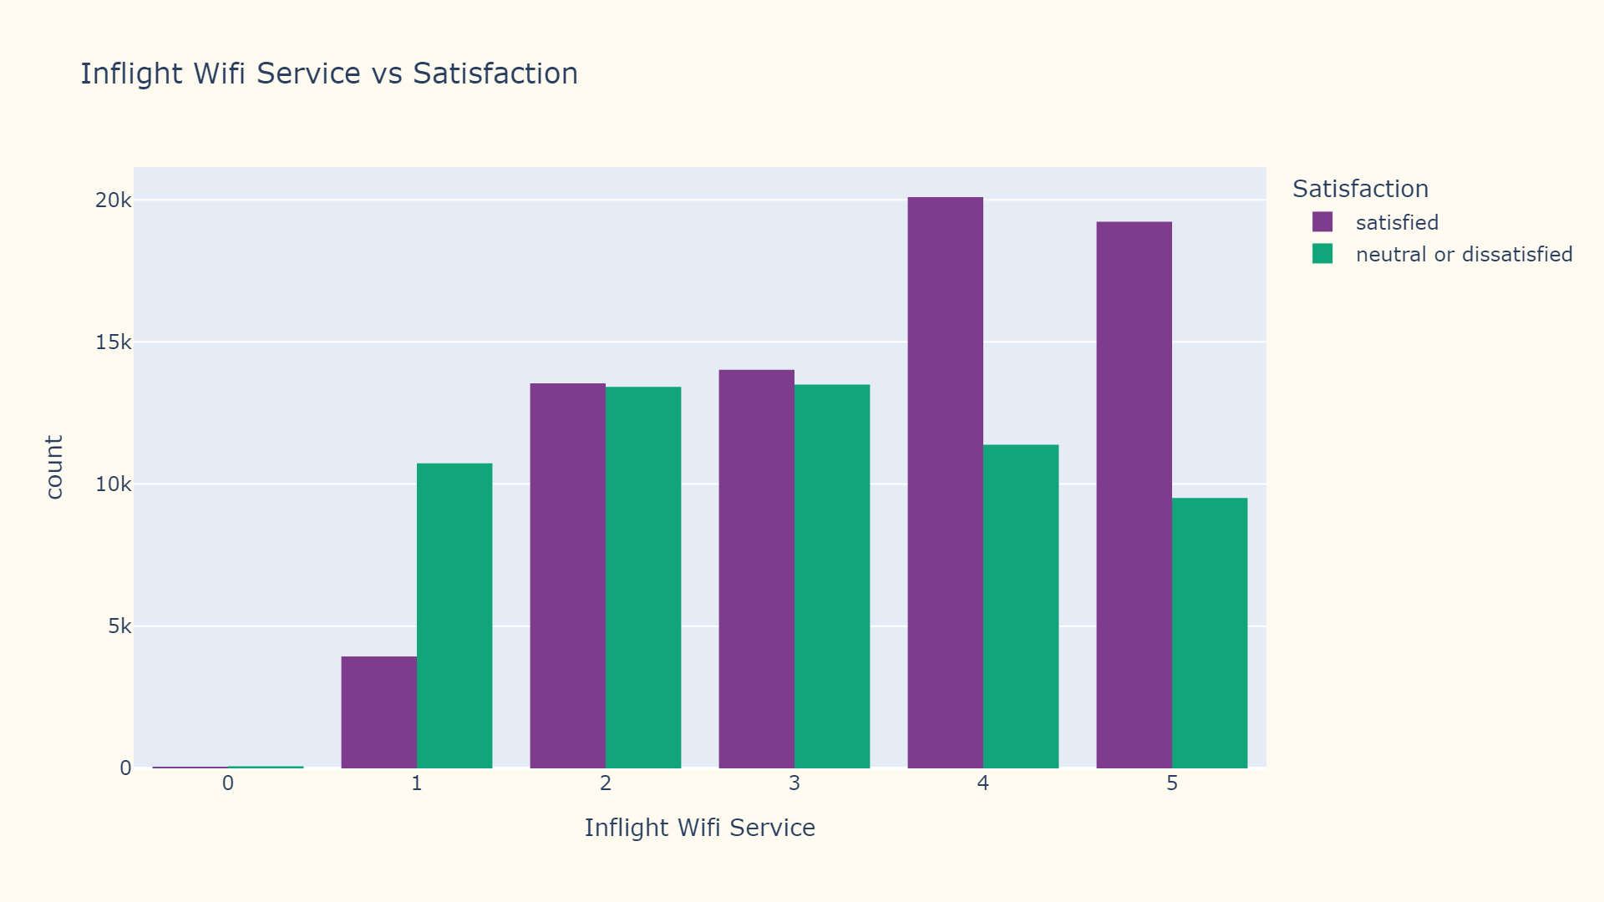

Slide 22
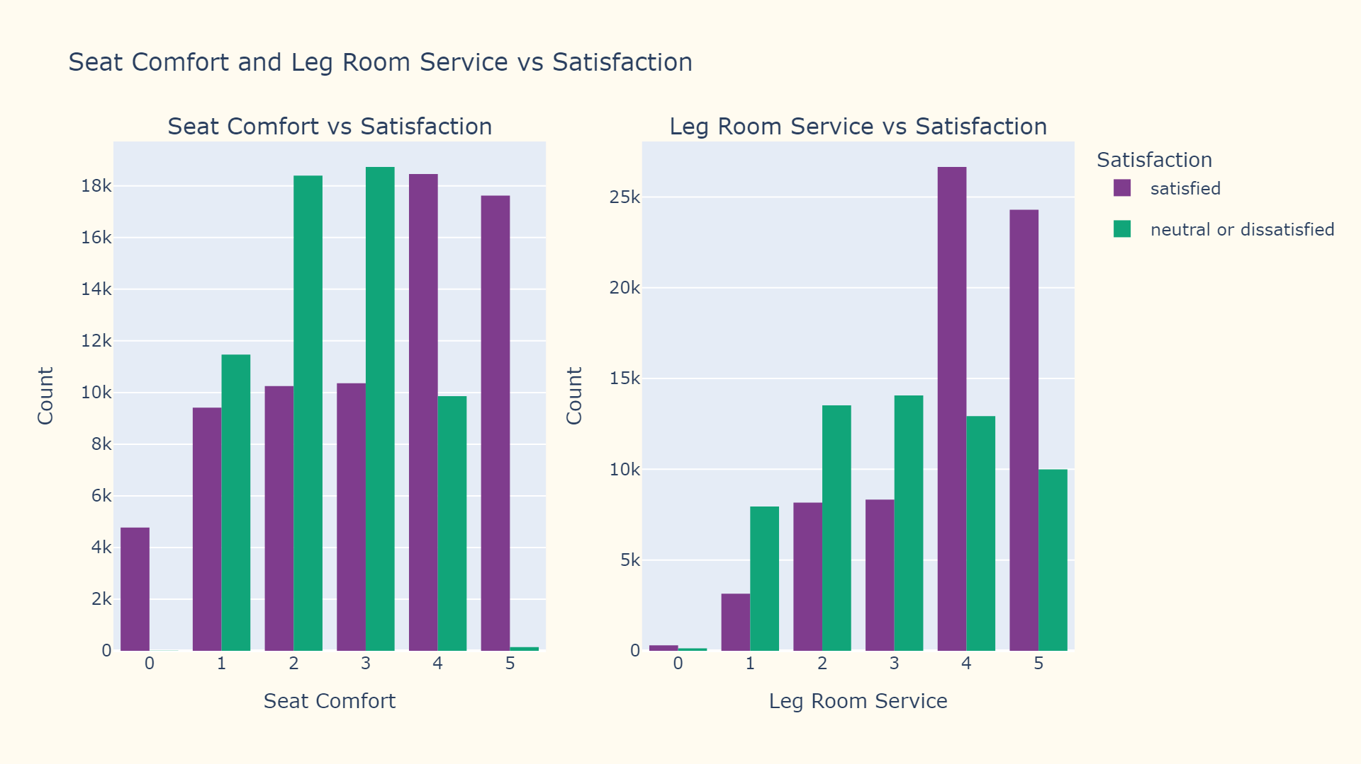

Slide 23
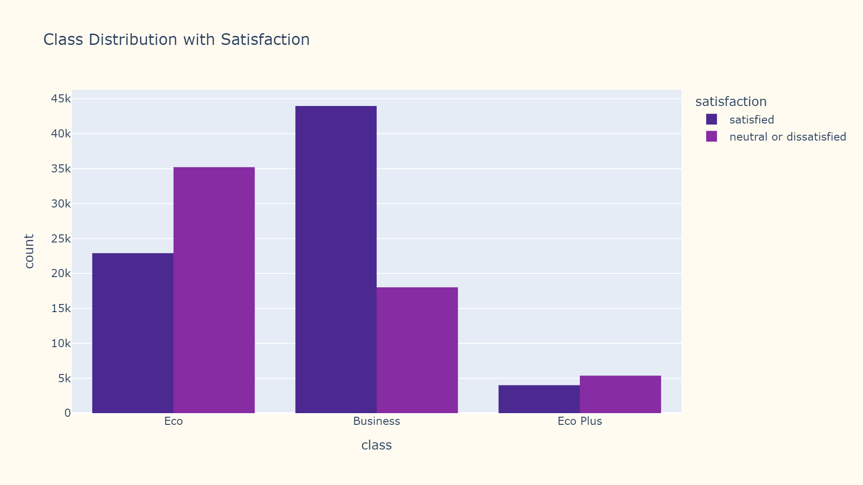

Slide 24
Data Preprocessing

Slide 25
Removed redundant identifier column 'id' to focus on relevant features for ML model training
Improved data readability through systematic column renaming and standardization (lowercase, underscores for spaces)
Removed the null values in the data as they were minimal and would not affect training in any way
Standardized target variable name from 'satisfaction_v2' to 'satisfaction' for clarity
Structured the departure/arrival time feature name for improved code maintainability

Slide 26
Implemented Label Encoding for categorical variables, transforming them into numerical format for model compatibility
Preserved Label Encoder mappings by serializing to 'label_encoder.pkl' for consistent future predictions
Implemented data partitioning using train_test_split with 85% training and 15% testing split
Applied StandardScaler for feature normalization to ensure all features contribute equally to model training
Preserved original feature distributions while normalizing data to mean=0 and standard deviation=1

Slide 27
Model Training

Slide 28
Logistic Regression
Accuracy: 83.51%
Precision: 84%
Recall: 84%
F1 Score: 84%
Hyperparameters
Max Iterations - 1000
Penalty - l2
Solver - lbfgs

Slide 29
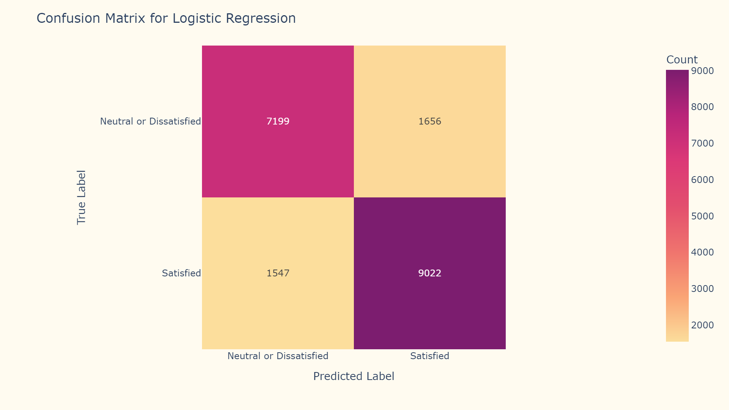

Slide 30
K Nearest Neighbors
Best Model: K=9
Accuracy: 92.48%
Precision: 93%
Recall: 92%
F1 Score: 92%
Hyperparameters
K - 2 to 15
Weights - uniform
Algorithm - auto
Metric - minkowski
P - 2

Slide 31
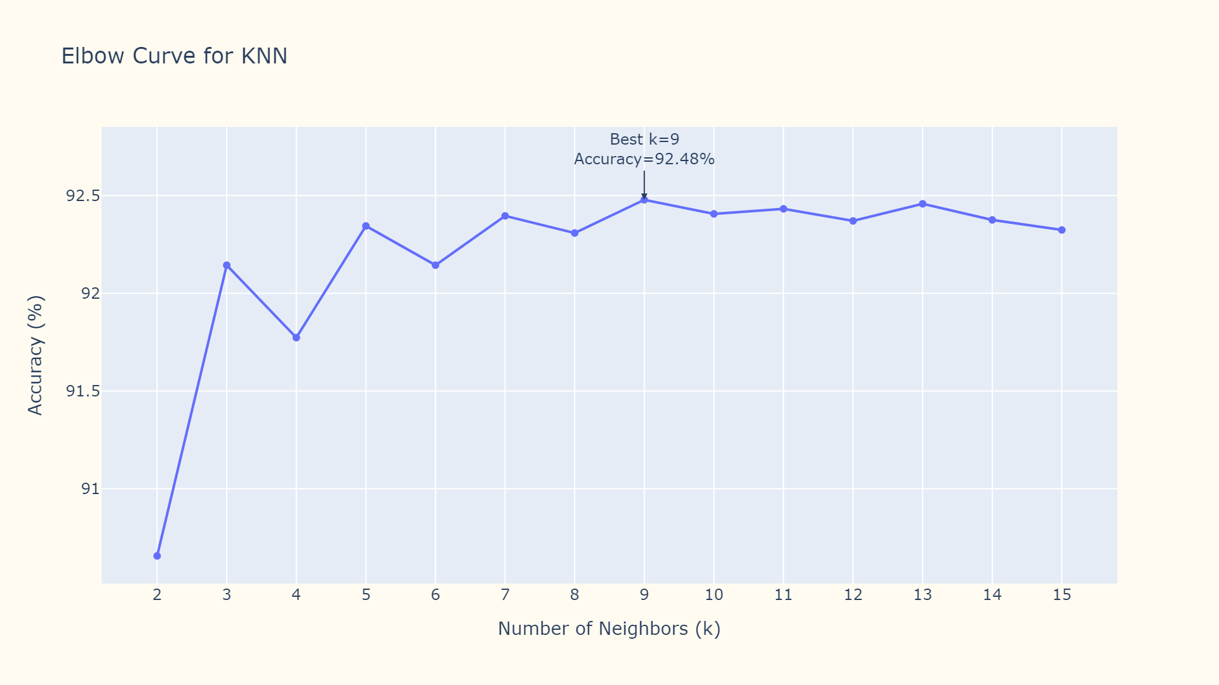

Slide 32
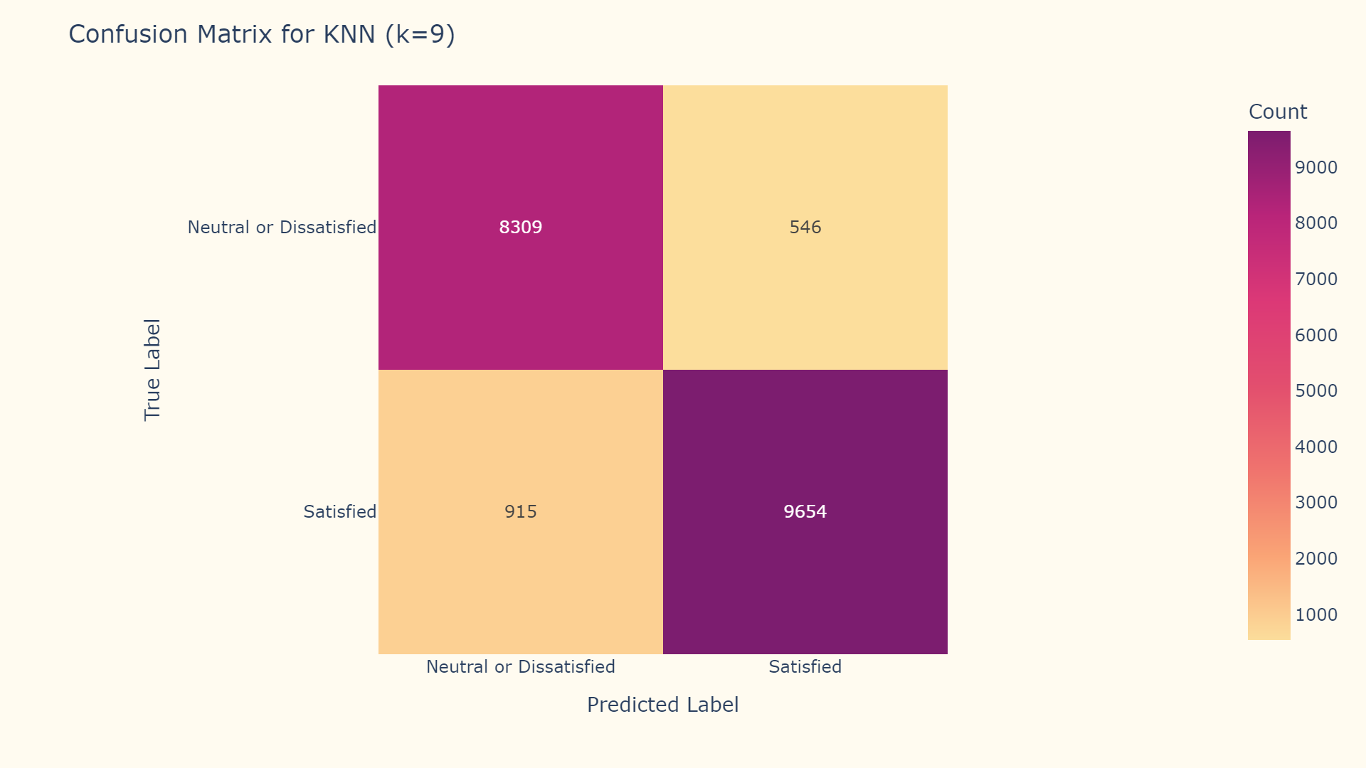

Slide 33
Decision Tree Classifier
Accuracy: 94.96%
Precision: 95%
Recall: 95%
F1 Score: 95%
Hyperparameters
Criterion - entropy
Splitter - best
Max Depth - 20

Slide 34
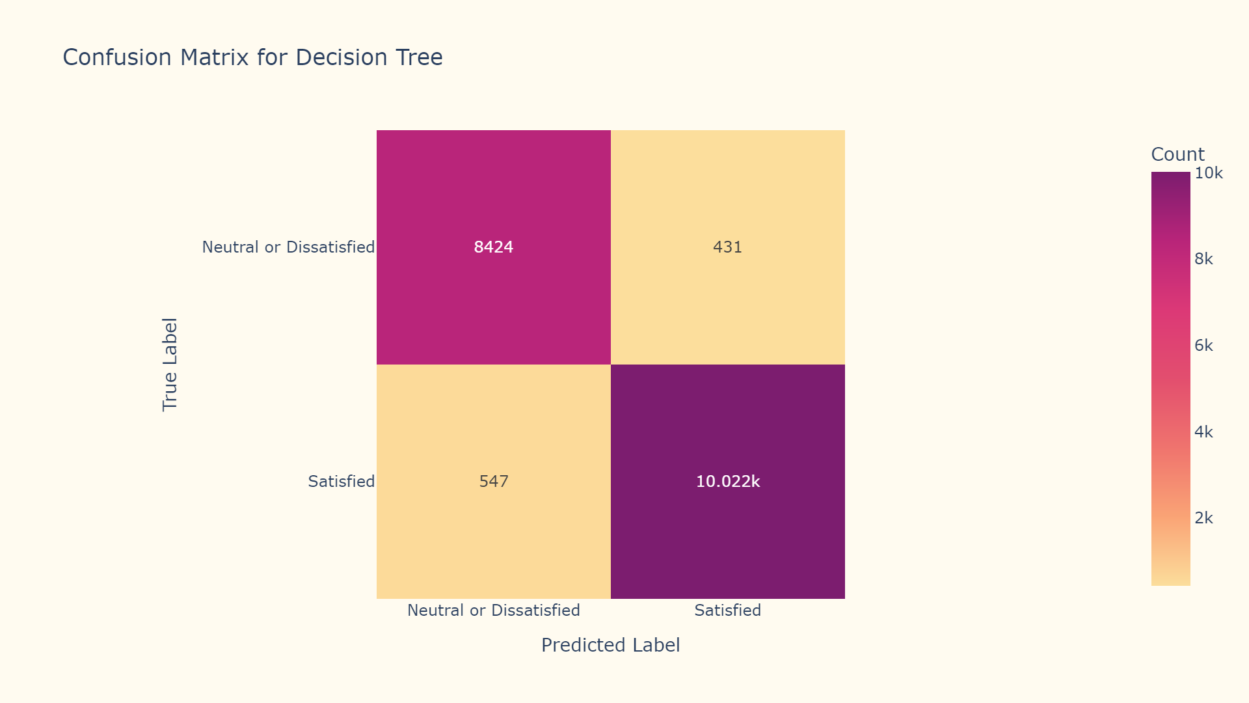

Slide 35
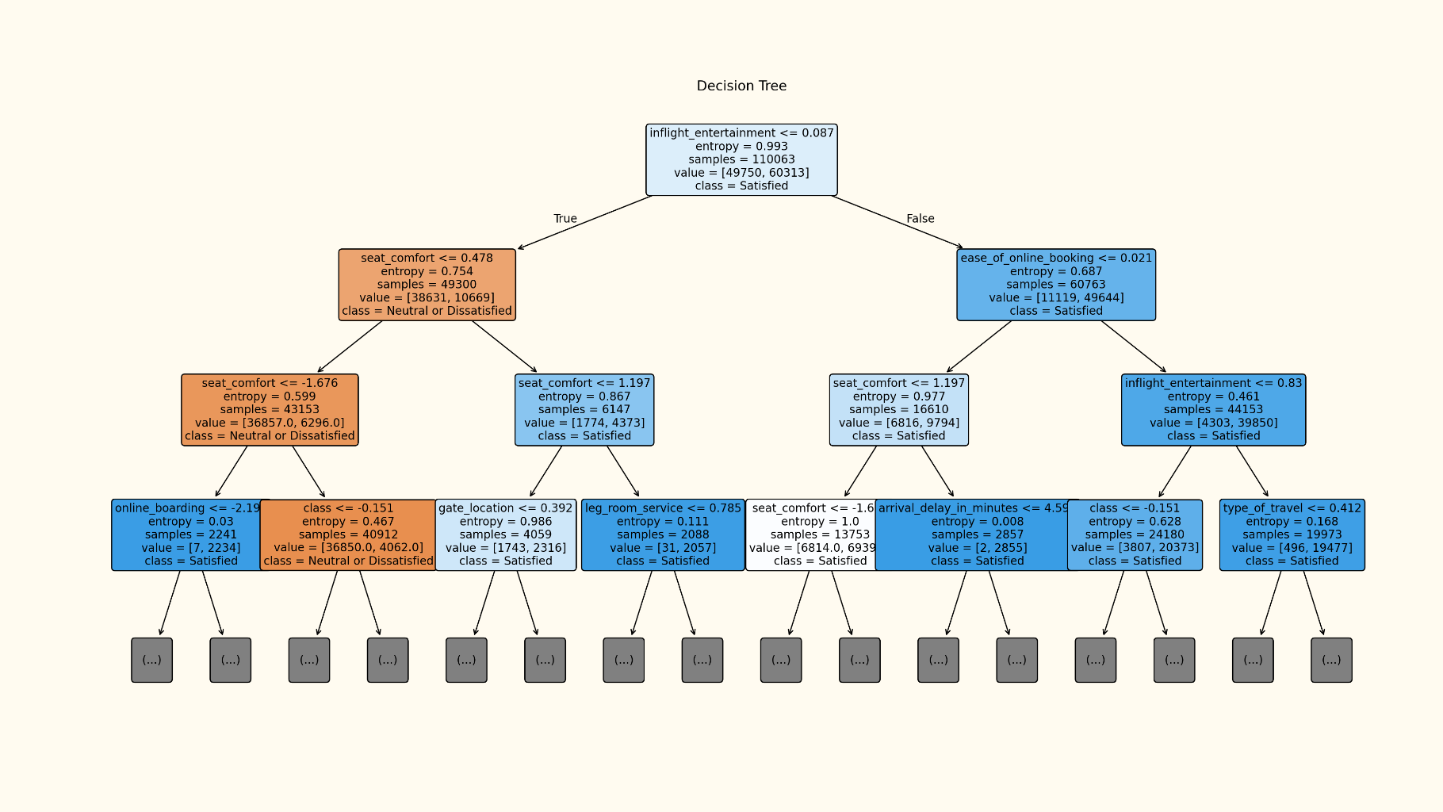

Slide 36
Random Forest Classifier
Accuracy: 95.91%
Precision: 96%
Recall: 96%
F1 Score: 96%
Hyperparameters
Estimators - 500
Criterion - log_loss
Max Depth - 20

Slide 37
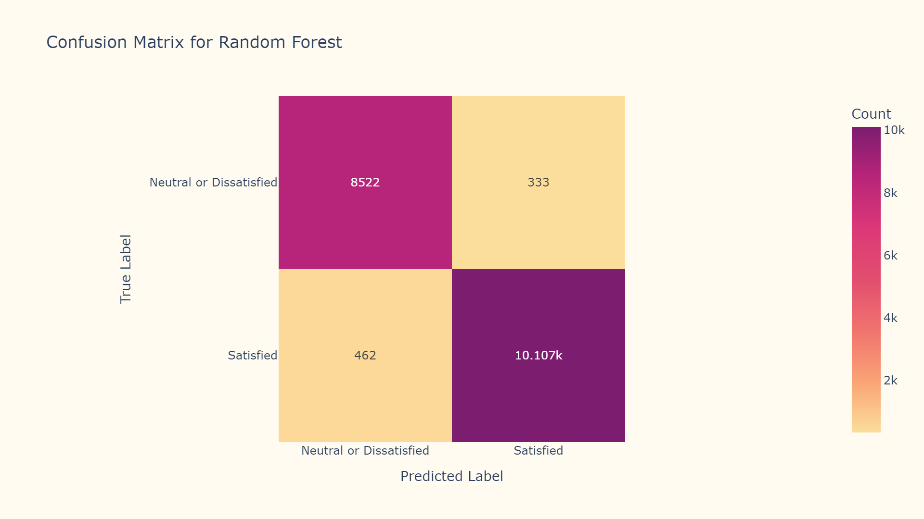

Slide 38
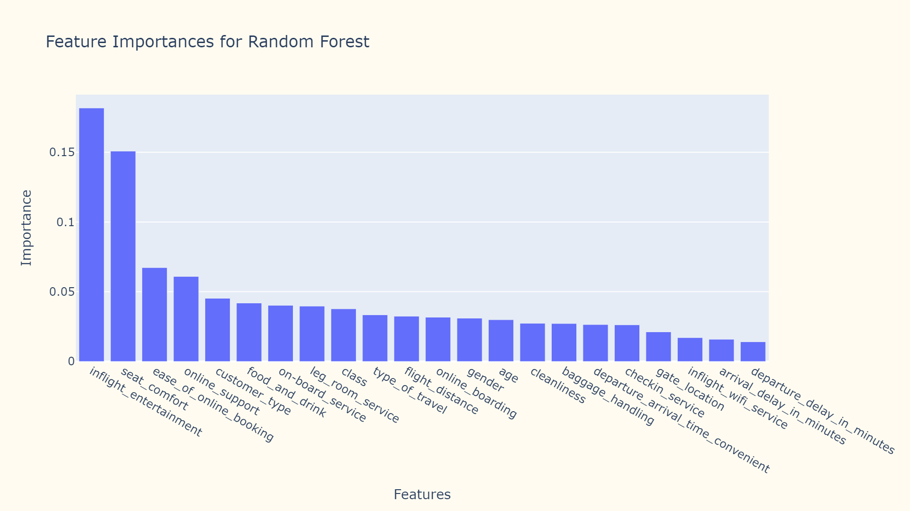

Slide 39
Support Vector Machines
Accuracy: 94.88%
Precision: 95%
Recall: 95%
F1 Score: 95%
Hyperparameters
Kernel - rbf
Gamma - scale

Slide 40
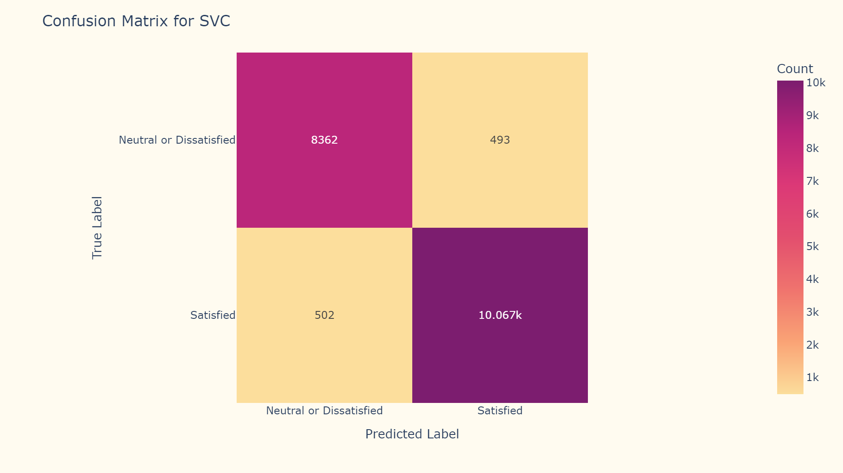

Slide 41
Artificial Neural Network
Accuracy: 95.88%
Precision: 96%
Recall: 96%
F1 Score: 96%
Hyperparameters
Total layers: 6 (2 Dense, 2 LSTM, 1 Reshape, 1 Output)
Parameters: 21,604
Activation Functions: ReLU (Rectified Linear Unit) for Dense Layers and Softmax for Output Layer
Optimizer: Adam(learning rate 0.001)
Loss function: Binary Cross-entropy
Max epochs: 100

Slide 42


Slide 43
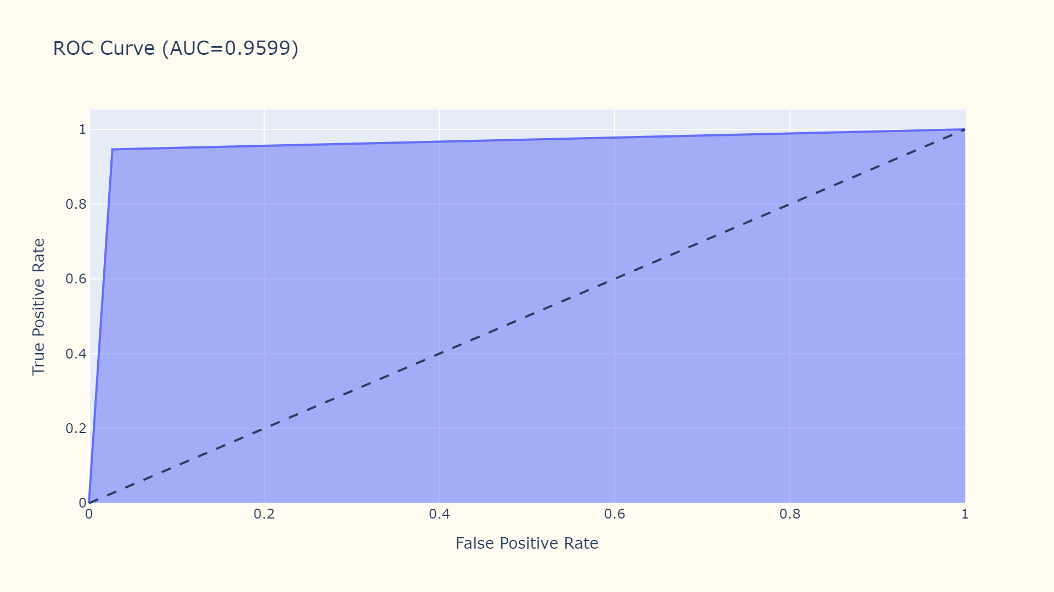

Slide 44
AdaBoost
Accuracy: 88.47%
Precision: 88%
Recall: 88%
F1 Score: 88%
Hyperparameters
Estimators - 1000
Learning Rate - 0.1
Algorithm - SAMME

Slide 45


Slide 46
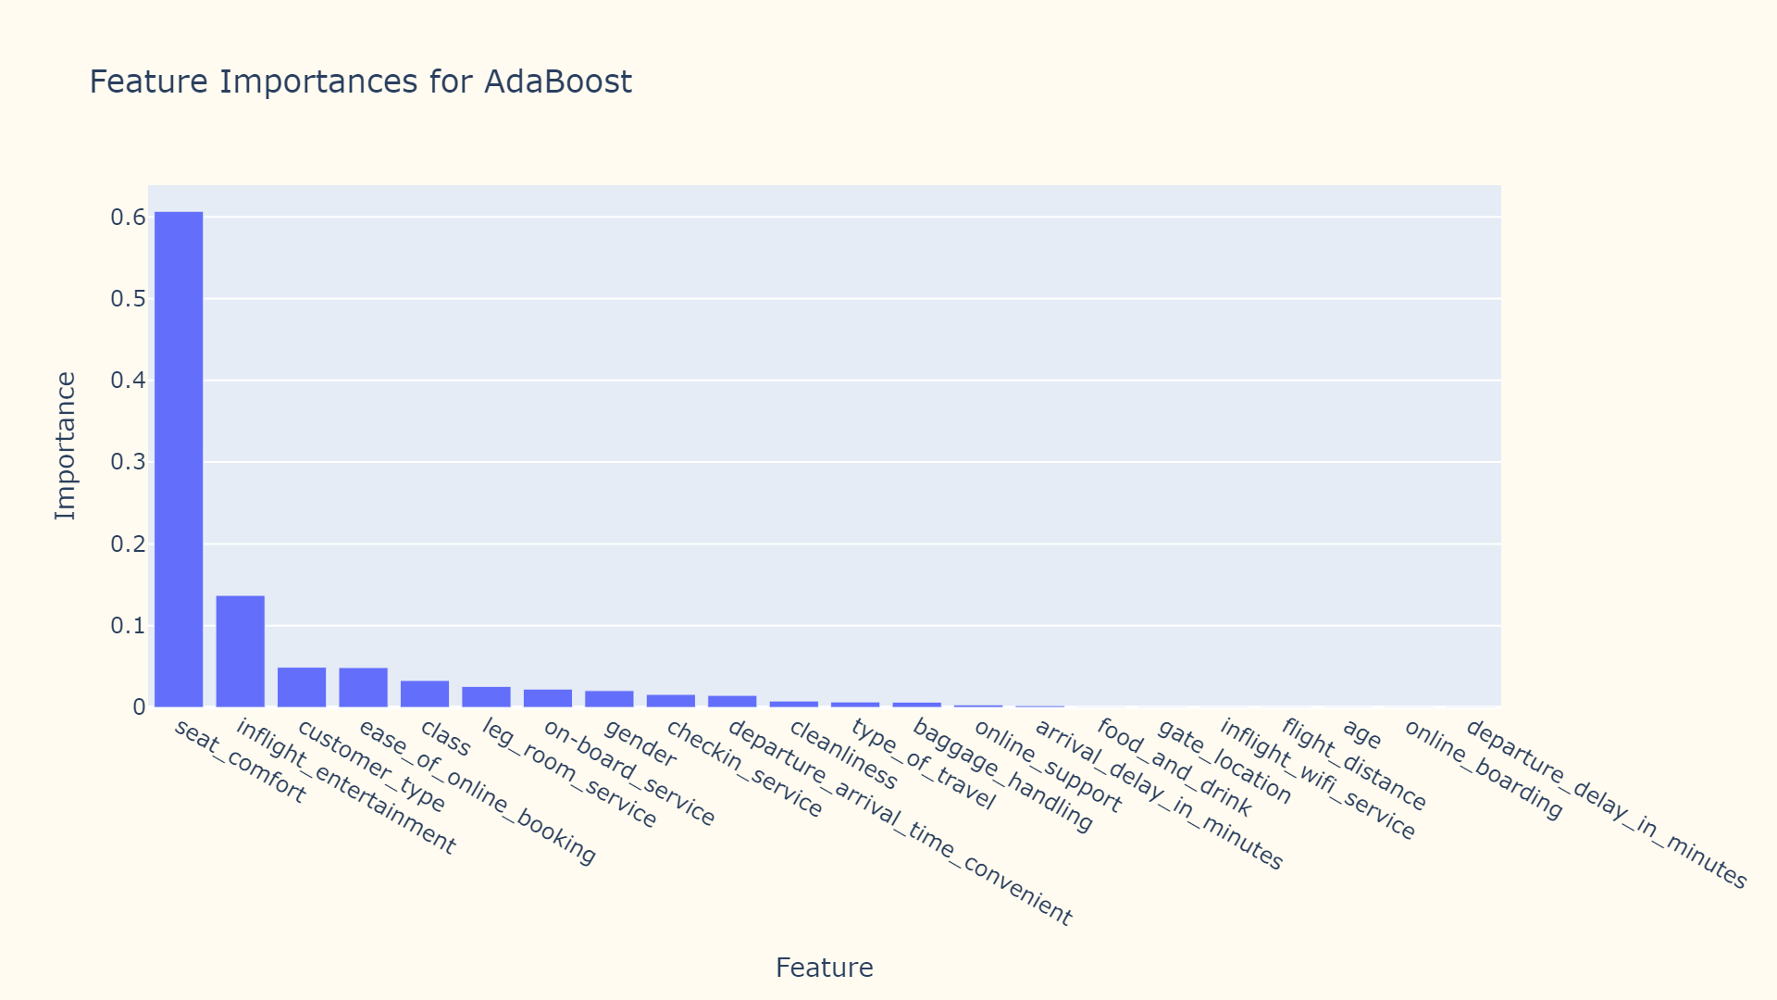

Slide 47
XG Boost
Accuracy: 96.04%
Precision: 96%
Recall: 96%
F1 Score: 96%
Hyperparameters
Estimators - 2000
Learning Rate - 0.05
Max Depth - 12
Subsample - 0.9
Colsample Bytree - 0.9

Slide 48


Slide 49
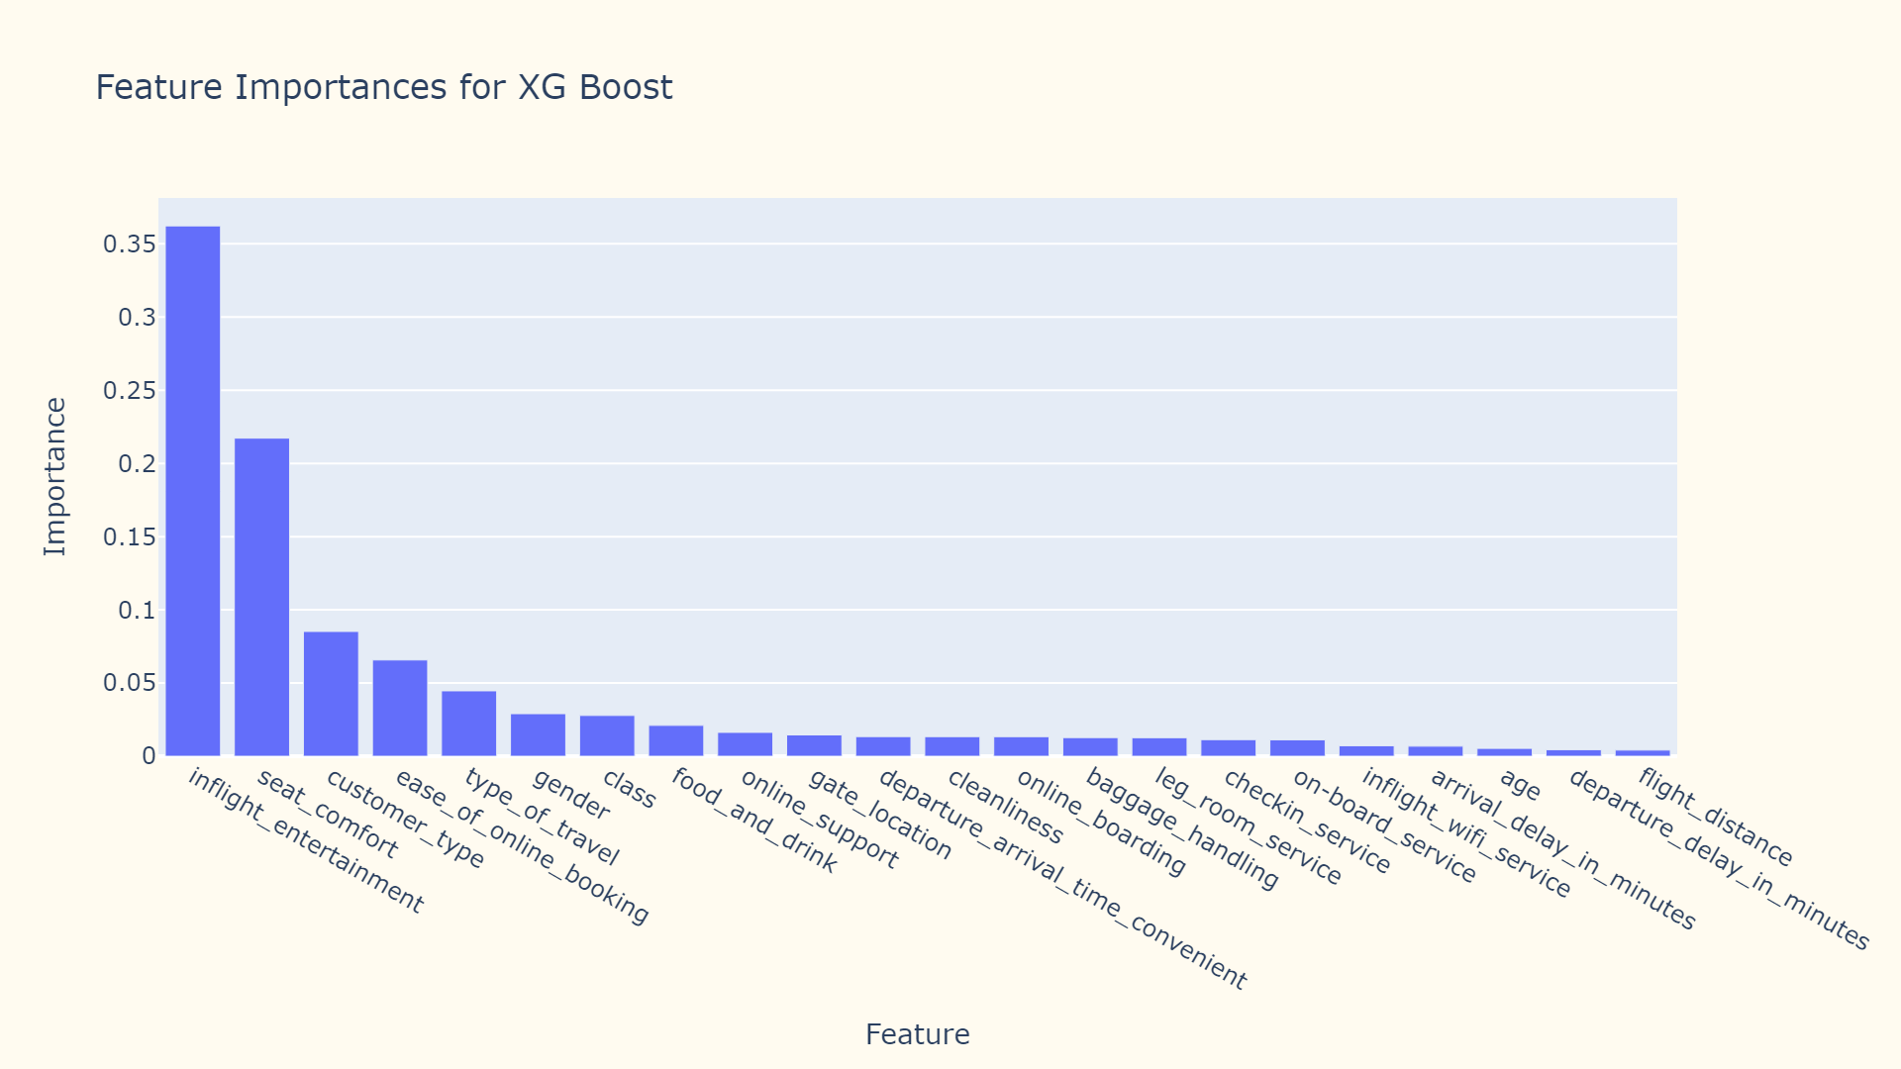

Slide 50
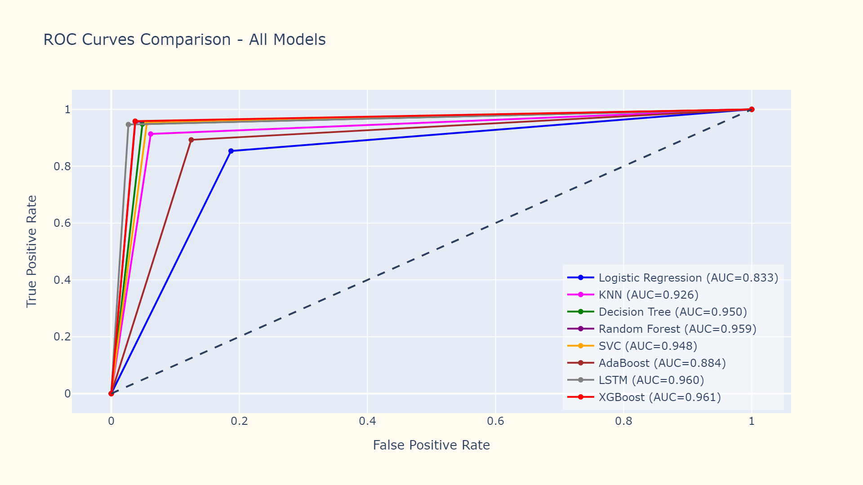

Slide 51
Model | Accuracy
XGBoost | 96.04%
Random Forest | 95.91%
Long Short Term Memory | 95.88%
Decision Tree | 94.96%
Support Vector Machines | 94.88%
K Nearest Neighbor(K = 9) | 92.48%
AdaBoost | 88.47%
Logistic Regression | 83.51%

Slide 52
Conclusion

Slide 53
Associating In-flight services with customer satisfaction was a crucial step in the Exploratory Data Analysis
XGBoost and Random Forest models are performing extremely well on this dataset
ANN with LSTM almost matched XGBoost on the test set but it had an extremely lengthy training time
The next steps of this project is to train the models for different ratios of data split
Since XGBoost and Random Forest are the top performing models, the objective is to focus on these algorithms with different hyperparameters

Slide 54
Thank you!
GitHub: https://github.com/PradHolla/KDDM-Final-Project

